Slide 1
Login or Register
Dashboard
About Us
Contact Us
News
Search(icon)
Home PAGE(App Name instead)
Details about the app, How to use it etc below
Image in bg

Slide 2
Welcome Page
Welcome!
LOGO
Login
Register
)
Contact Us
News
Image in bg

Slide 3
LOGIN PAGE(App Name instead)
Image in bg
Mobile Number/Email
Password
Remember me
Login
Forget Password?
OR
Register

Slide 4
Registration PAGE(App Name instead)
Name:
DOB
Address:
Gender:
Email:
Phone Number:
Password:
Repeat Pass:
Subscription:
Free, monthly, yearly
Register
Image in bg

Slide 5
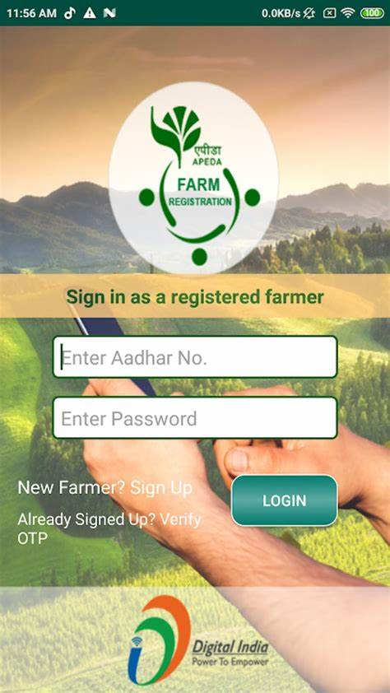
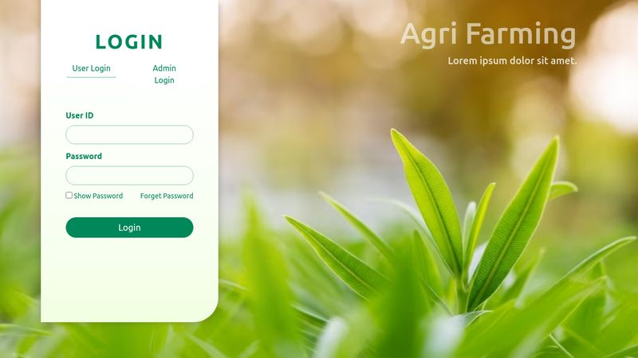

Slide 6
C
Dashboard(App icon)
Weather icon
Image in bg/ colour
Collapse button
Home
My Account
Selling
Buying
Purchase Info
Search Bar(with icon)
Recent searches
Eg: Potatoes
Eg: Banana
Recent search products updates
Image in bg

Slide 7
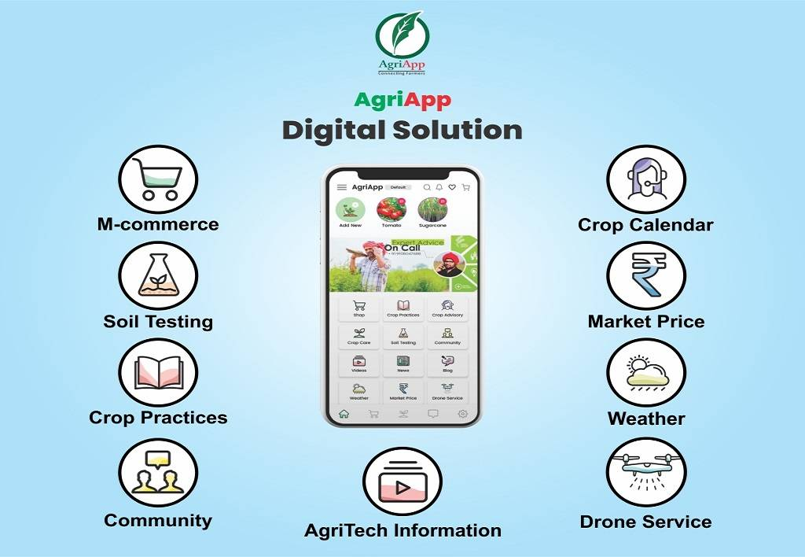
Home page

